Slide 1




Dr James Bedford
ST5 Anaesthesia/Intensive Care Medicine
PQIP fellow
@jbedford84

Slide 2

Project overview
Enhanced recovery recommendations; five process measures
Dashboard display; reporting ER recommendations and risk-adjusted morbidity outcomes
Top 20 recruiting colorectal sites
Part of PQIP - no additional data collection

Slide 3

Reporting outcome data

Slide 4
Defining postoperative complications
Using the Postoperative Morbidity Survey¹ (POMS) on postoperative day 7
POMS major²
Major morbidity (e.g. requirement for a new therapy or a diagnosis of a complication) not a minor deviation from usual course (e.g. urinary catheter)
Bennett-Guerrero E, Welsby I, Dunn TJ, Young LR, Wahl T a, Diers TL, et al. The use of a postoperative morbidity survey to evaluate patients with prolonged hospitalization after routine, moderate-risk, elective surgery. Anesth. Analg. 1999;89:514–9.
Wong DJN, Oliver CM, Moonesinghe SR. Predicting postoperative morbidity in adult elective surgical patients using the Surgical Outcome Risk Tool ( SORT ). Br. J. Anaesth. 2017;119:95–105.

Slide 5
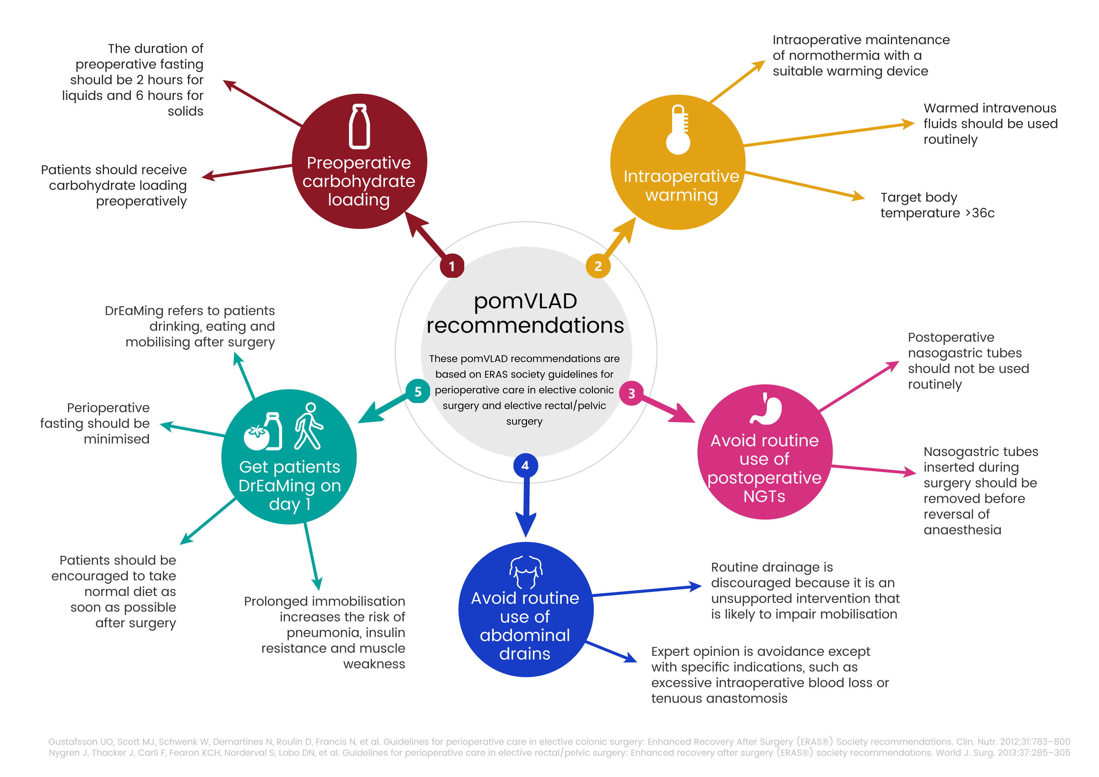

Slide 6
pomVLAD: Variable life-adjusted display
Risk-adjustment model is used to estimate the risk of postoperative morbidity for each patient
The outcome is either: 1 = morbidity or 0 = no morbidity
The chart is then created as a continuous plot using expected minus observed outcome for each subsequent patient
  So, if risk of morbidity for a patient is 15%, and that patient has morbidity, then: 0.15 - 1 = -0.85
  if they do not have morbidity: 0.15 - 0 = +0.15

Slide 7
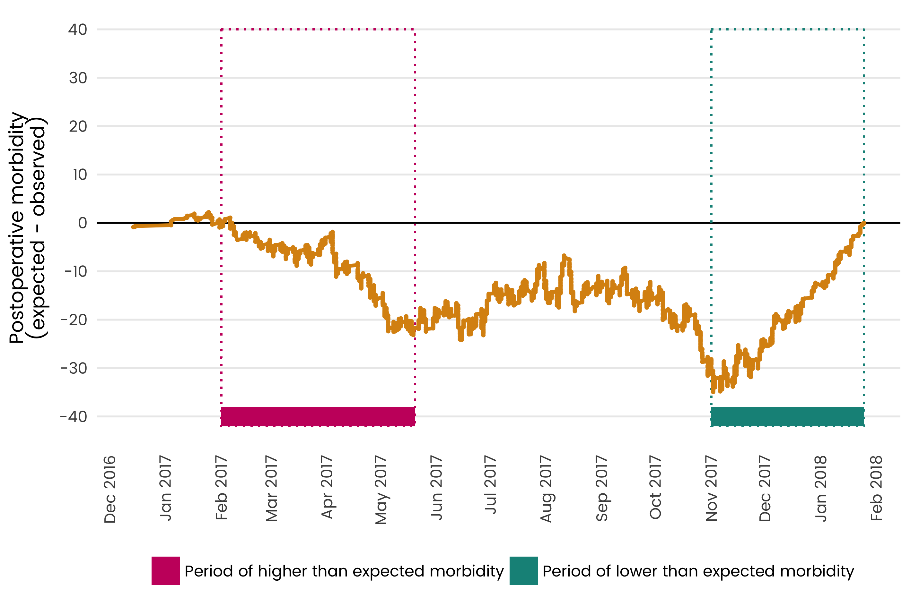

Slide 8
pomVLAD risk-adjustment model
Produced using data from 14 months of PQIP, 4466 patients
Final model includes 10 preoperative patient and surgical variables
Performance favourable compared to POSSUM and SORT morbidity

Slide 9
Risk modelling
Surgical specialty
Severity of surgery
Gender
ASA grade
BMI
Heart rate
Systolic BP
Age (years)
Number of operations in last 30 days
Respiratory history findings

Slide 10
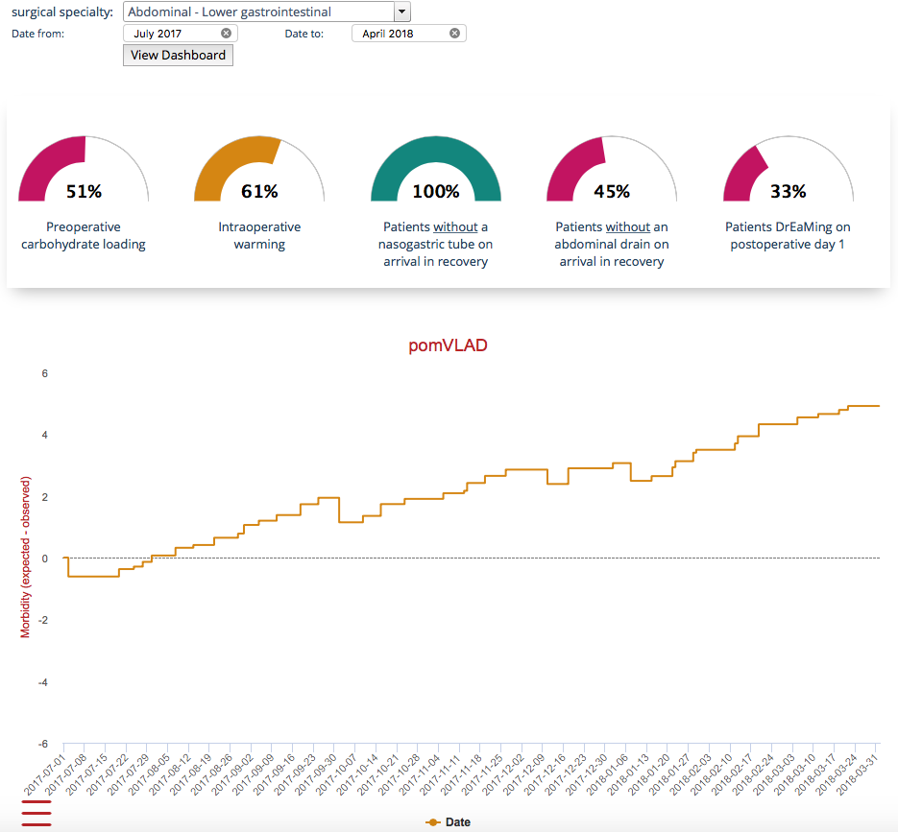
Dashboard display
Notes:
Some measures will update as soon as data is entered (engagement and process measures), others will update as soon as records are locked

Slide 11
Implementation
Now live!
10 sites will receive recommendations and dashboard
Recommendations accessible to all other sites
Available through PQIP webtool

Slide 12
Project evaluation
Project planned to run for initial 12 months
Evaluation based on quantitative and qualitative outcomes
Telephone interviews with teams at some sites receiving the dashboard

Slide 13
Questions
twitter: @jbedford84
www.pqip.org.uk
twitter: @PQIPNews

